Slide 1
CAB302
GrAIde Predictor

Slide 2
1. Project Overview

Slide 3
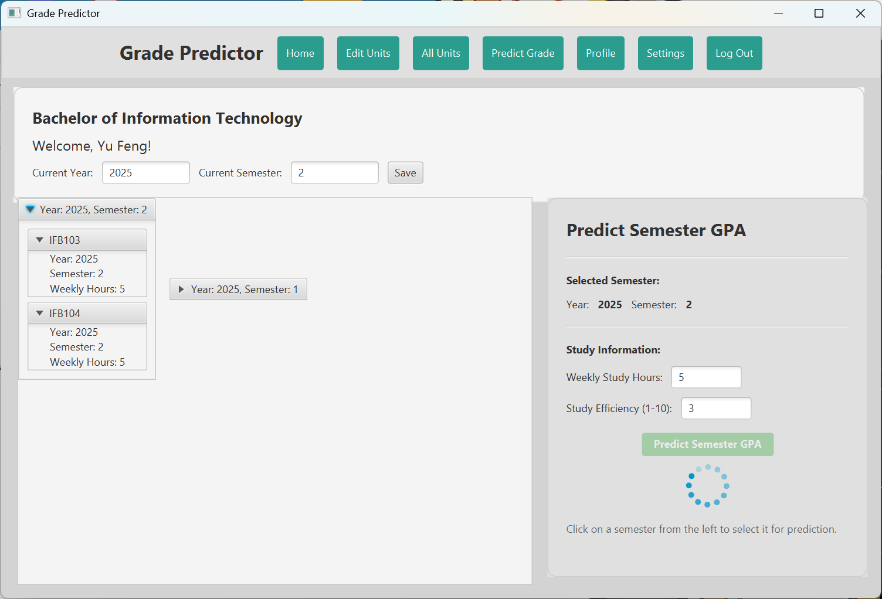
Purpose
AI grade predictor designed to help students achieve their academic goals!

Slide 4
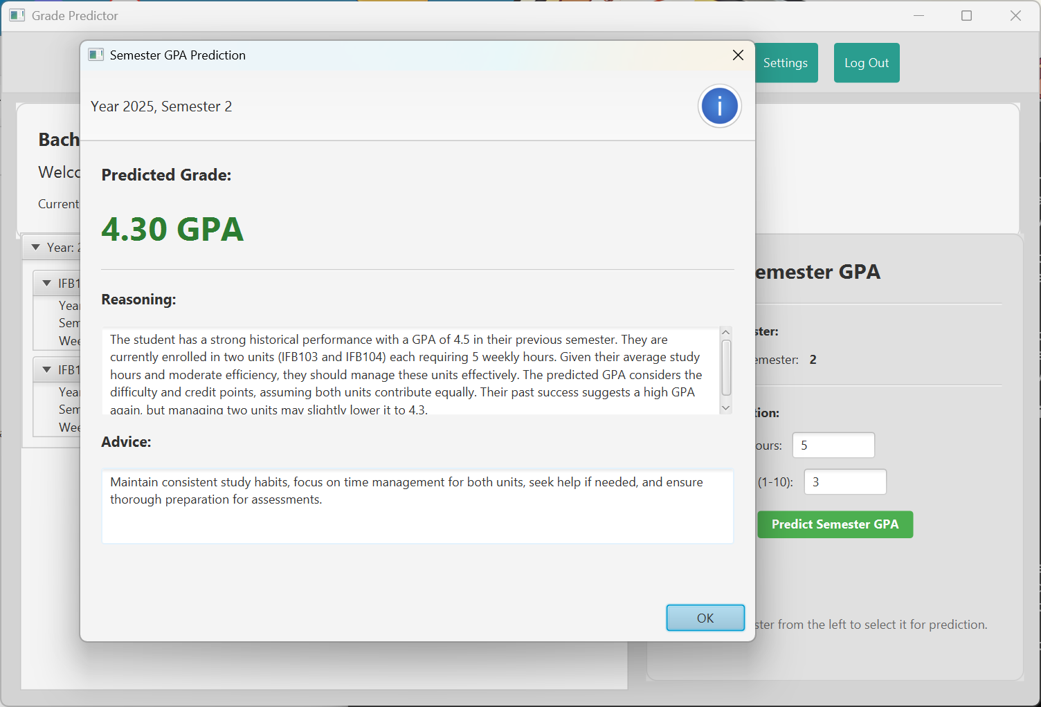
Key Features
Grade Prediction
Units Dashboard
Profile – loin/sign-up
Insightful advice on next steps to improve GPA

Slide 5
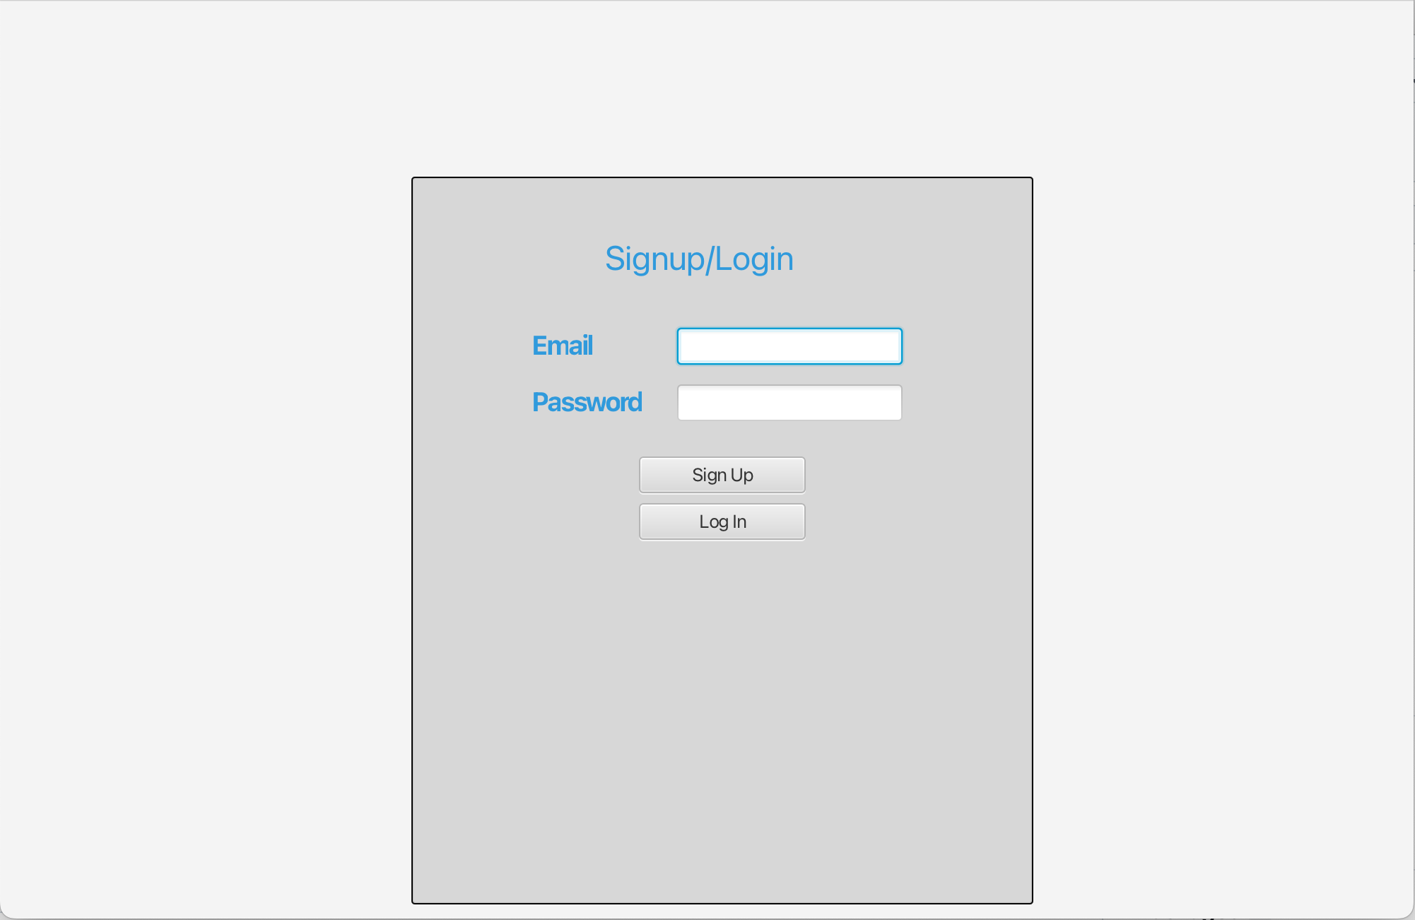
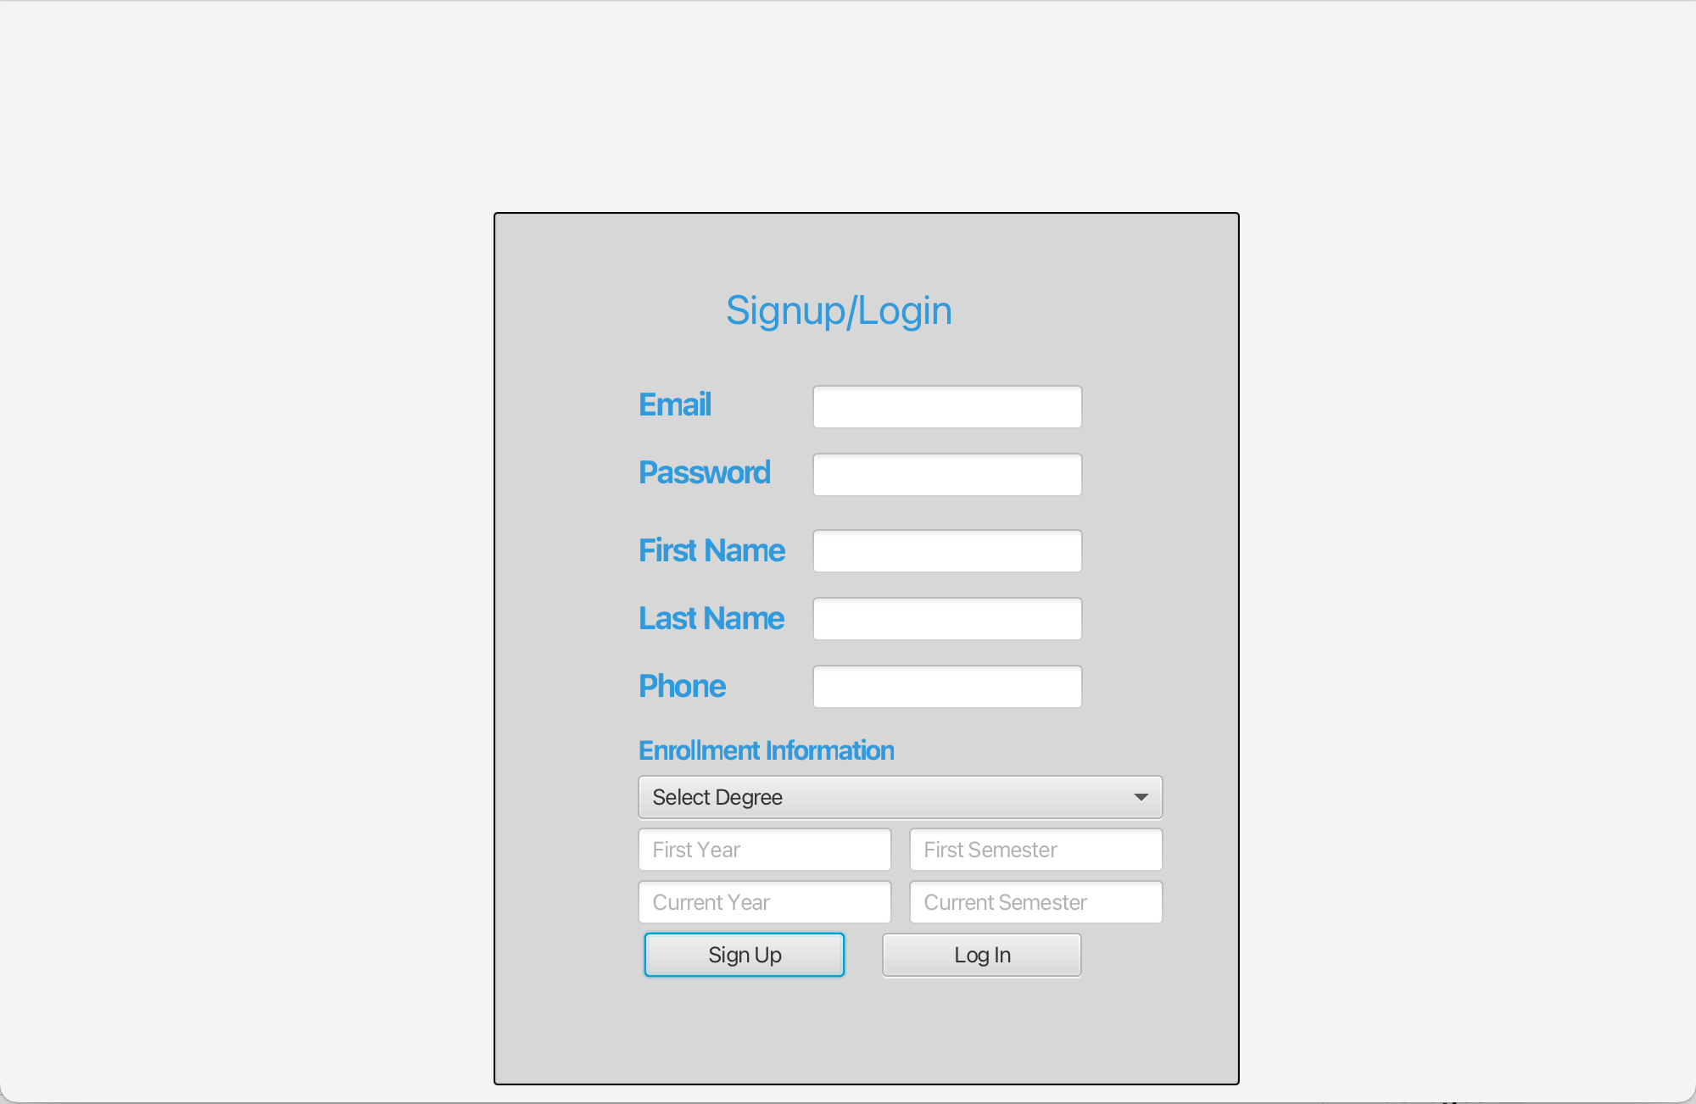

Slide 6
2. Project Planning and Design

Slide 7
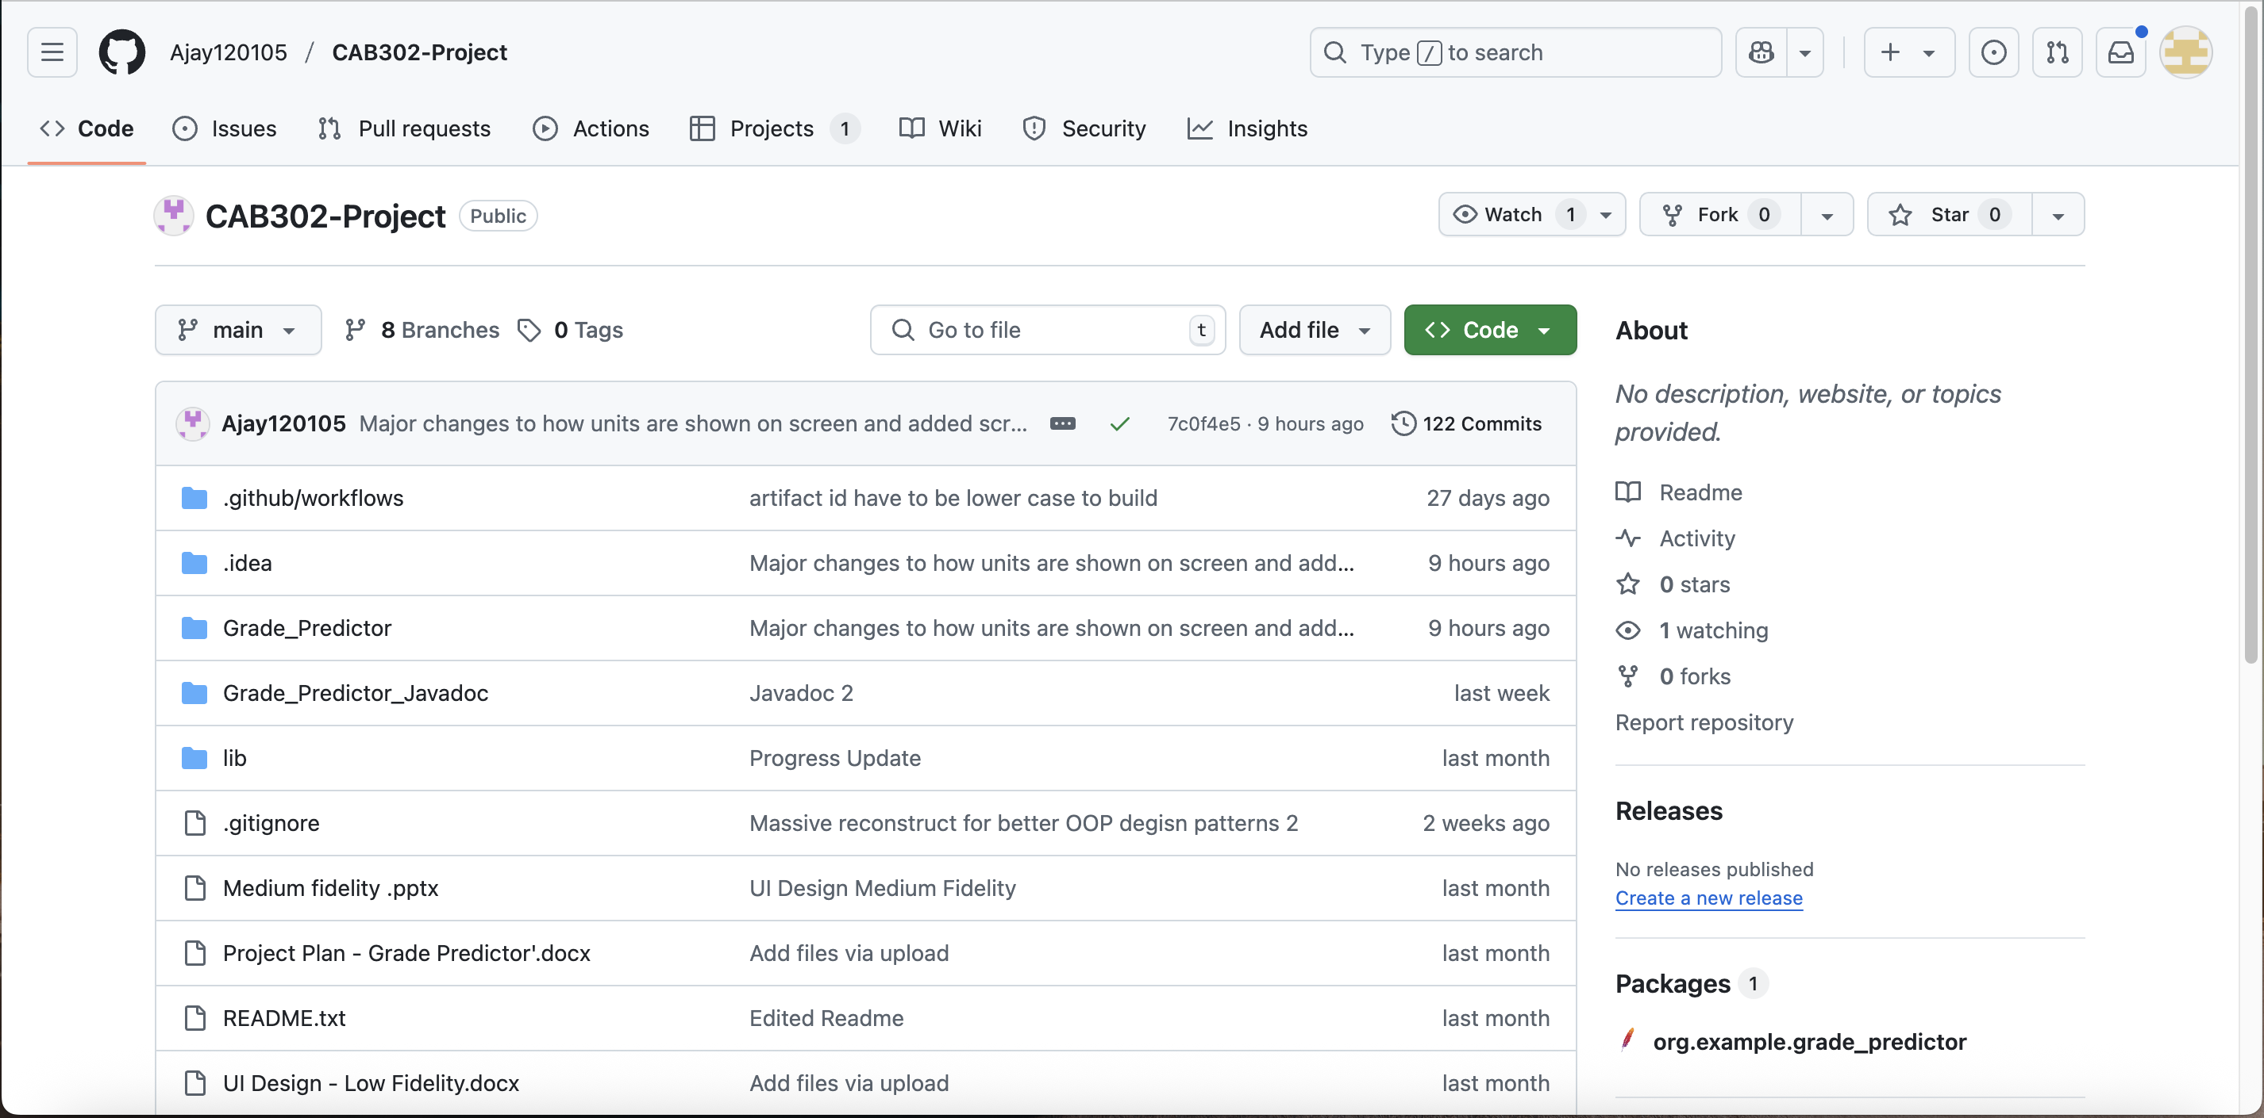
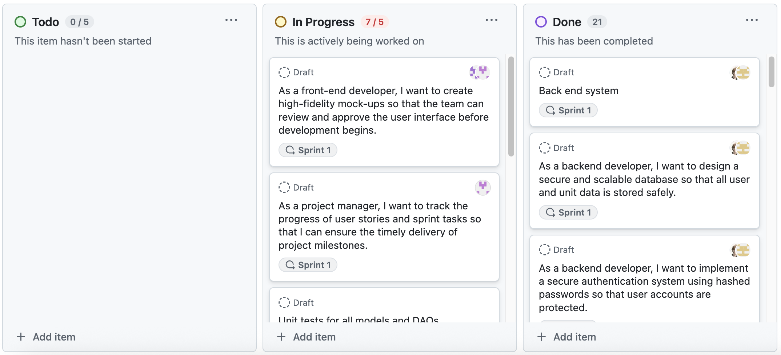
Project Plan and Design
GitHub
GitHub - Projects

Slide 8
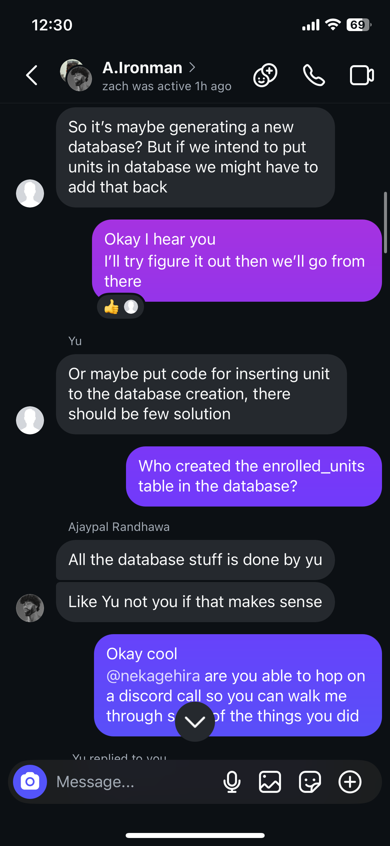
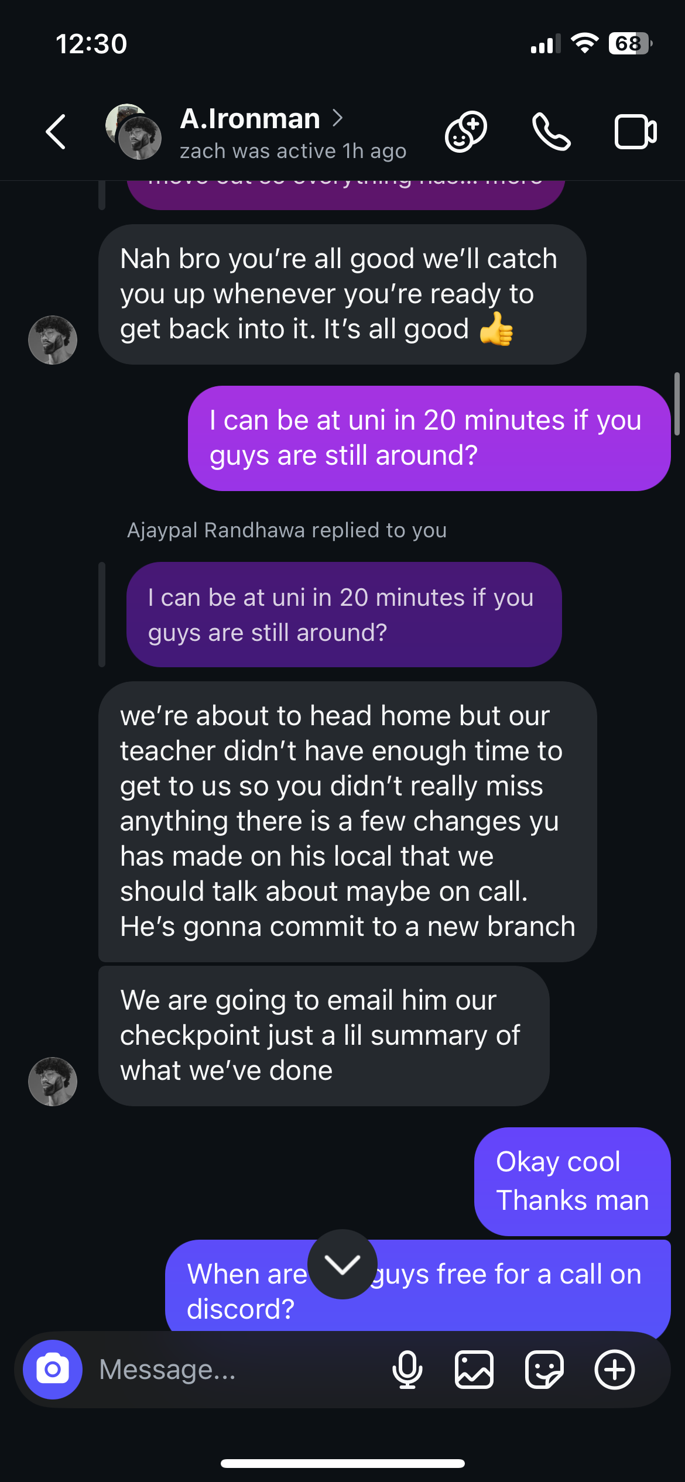

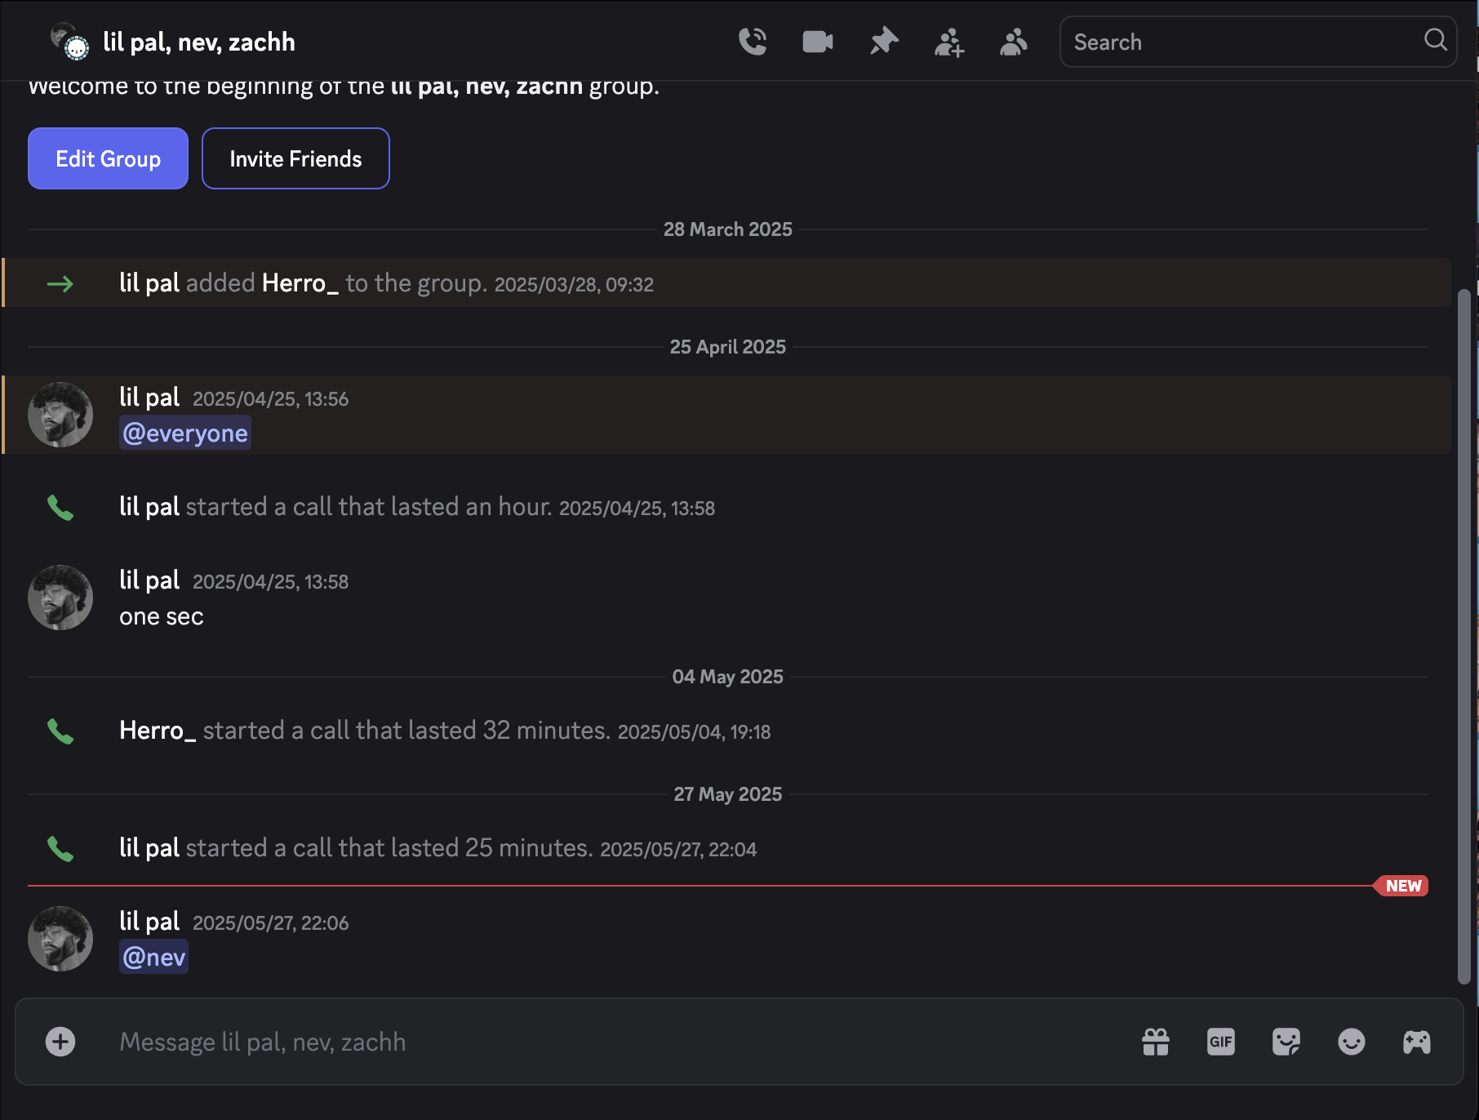

Slide 9
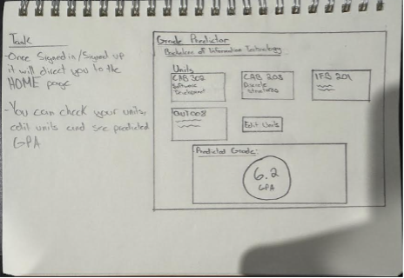
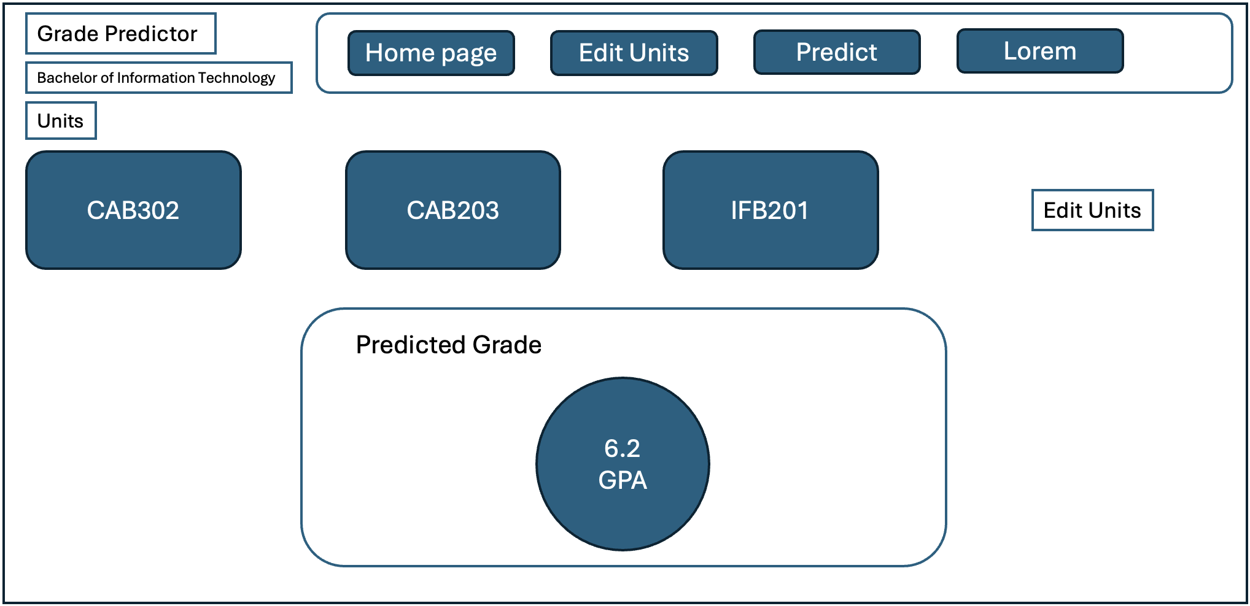
Project Features

Slide 10
User stories summary
As a student, I want to create an account using my email and password so that I can use the application securely.
As a student, I want to log in to my account so that I can access my saved units and predictions.
As a student, I want to input my current and past units with grades and study effort so that I can receive accurate grade predictions.
As a student, I want to view predictions based on data entered so that I can understand my potential grade.
As a student, I want to edit or delete unit entries so that my data stays up to date.
As a student, I want to receive confirmation after saving/updating data so that I know it worked.

Slide 11
3. Technical Details

Slide 12
JAVA FX
Java UI
TECHNICAL DETAILS
CONTROLLERS
Handles events
AI Model
SERVICES
GSON
OLLAMA 4J
UTILITIES
Logic, Objects, etc.
DAO’S
Data Persistence
SQLite

Slide 13

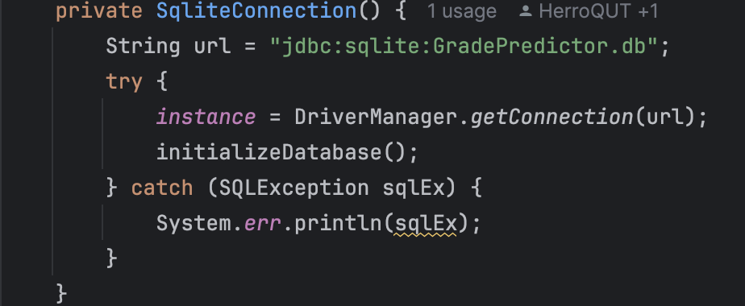

DATA HANDLING

Slide 14


Ollama 4j
LIBRARIES

Slide 15
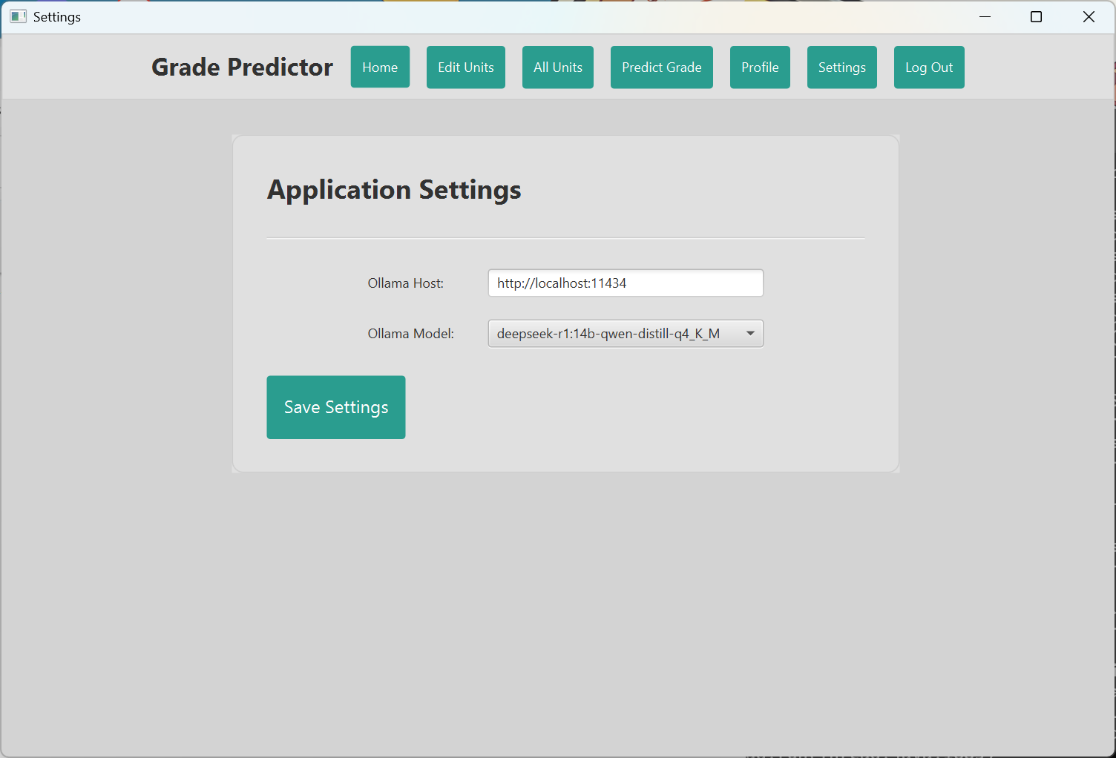
Main Component

Slide 16
4. Project Quality

Slide 17
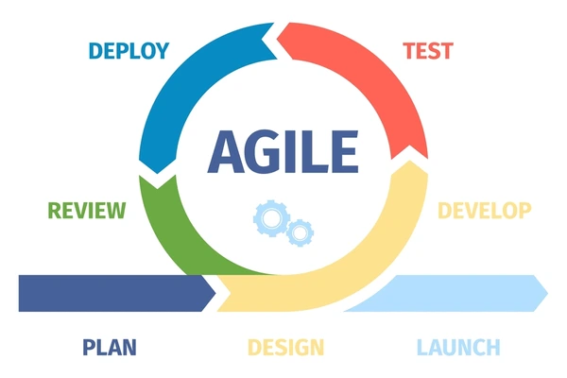
Project Quality - AGILE
User Stories
Sprint Planning
Prioritisation

Slide 18

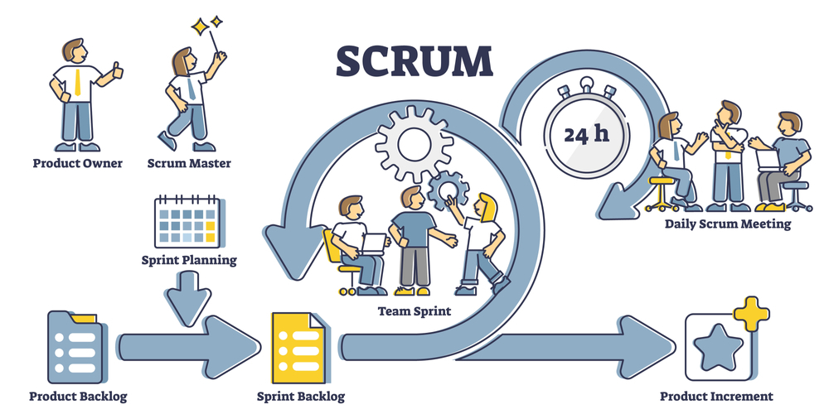
What worked well
Consistent Communication
Scrum Meetings - Weekly

Slide 19
5. Teamwork

Slide 20


TEAMWORK
Used projects tab in GitHub to manage tasks and track progress
Held video and group calls on Discord
Maintained clear and honest communication around various things such as ‘Deadlines’
Always made an effort to communicate through problems and while under pressure

Slide 21

TECHNICAL ISSUES

Slide 22
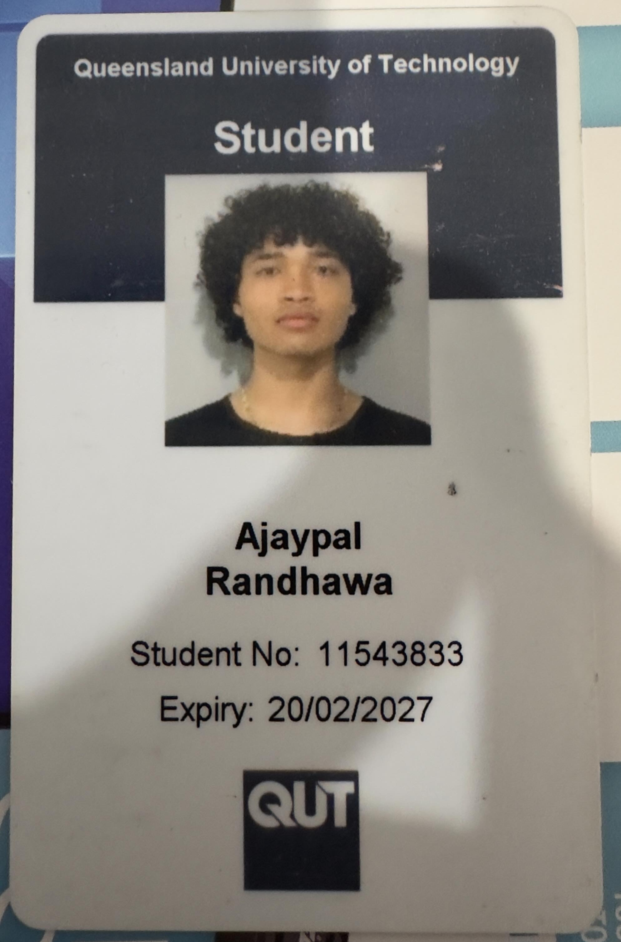

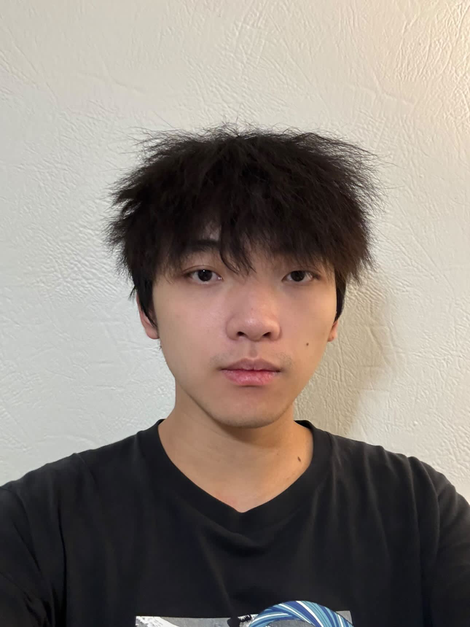

Team
Ajay
Front-end Developer
Zach
Front-end Developer
Yu
AI Developer
Herro
Backend Developer

